Slide 1
Power electronic and drives: ELEC 2208 – 3
Chapter 1: Electromagnetic and Mechanical Fundamentals
Dr Frederic Gardes
University of Southampton

Slide 2
Overview
Chapter 1 covers the following basic definitions:
Moment of inertia
Friction
Path control
Power transmission
Torque balanced equation
Torque and kinetic energy
Exemples of connectors
Bearings
Coupling
Transducers

Slide 3
Power Transmission (linkage)

Slide 4
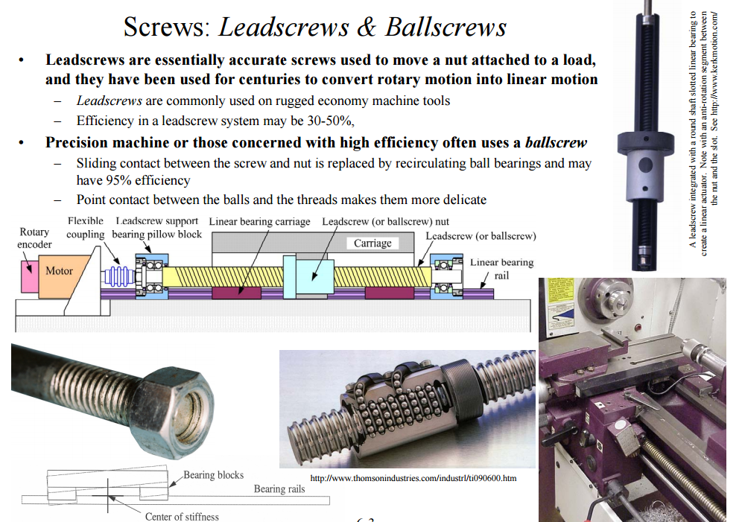

Slide 5
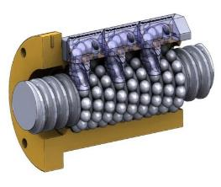
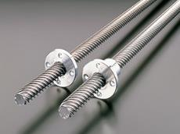
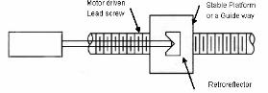
Power transmission: Ballscrew and leadscrew
Both convert rotary motion efficiently into linear motion.
Ballscrews have low friction and hence good dynamic response.
Leadscrews have direct contact between the screw and the nut and this leads to a relatively high friction (hence less efficient).

Slide 6
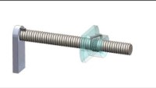
Background on ball screw

Slide 7
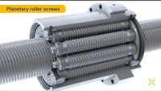
Background on roller screw

Slide 8
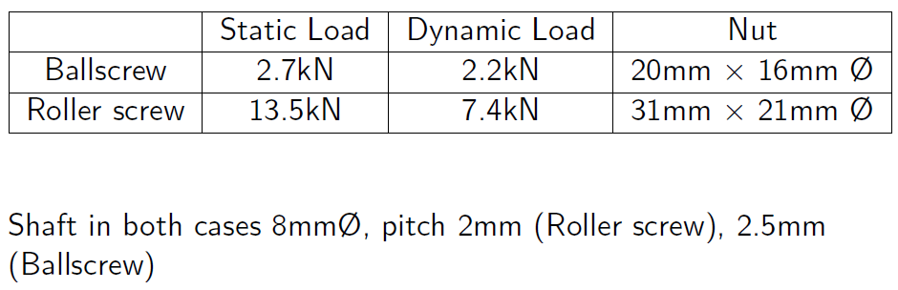
Ball Screw - Roller Screw comparison.

Slide 9
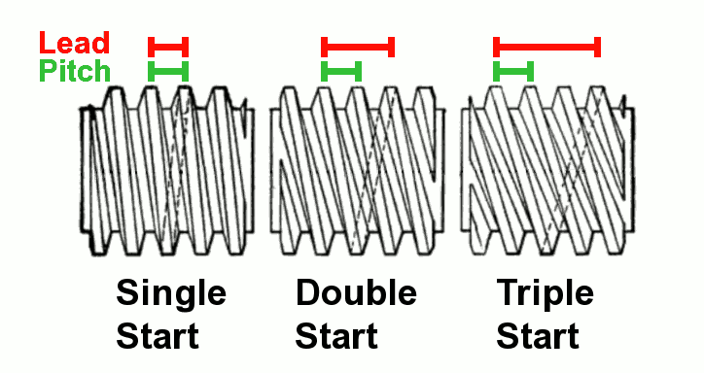
Definition of lead
The distance moved by one turn of the leadscrew is termed the lead.
Lead should not be confused with the pitch of the screw, which is the distance between the threads.

Slide 10
Proof - free body diagram
Other source, note the difference in symbols.
Consider an "unwrapped“ thread
Load force is downwards
Friction parallel to the hypotenuse.
-Normal reaction to the plane N
-Force applied at an angle P

Slide 11
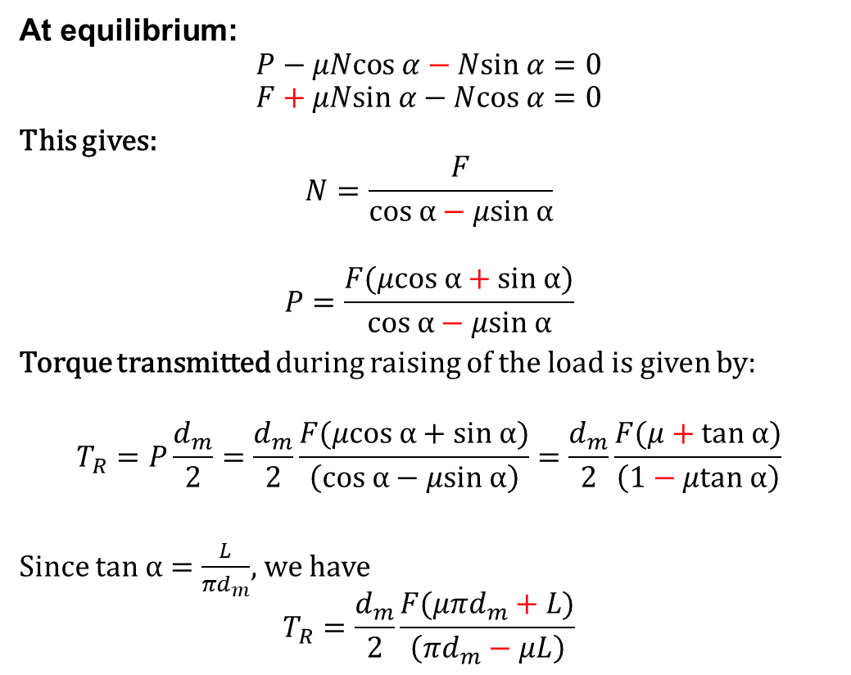
Proof - screw-raising torque
At equilibrium:
$$P−μNcos α−Nsin α=0$$
$$F+μNsin α−Ncos α=0$$
This gives:
$$N=\frac{F}{cos α−μsin α}$$
$$P=\frac{F(μcos α+sin α)}{cos α−μsin α}$$
Torque transmitted during raising of the load is given by:
$$T_{R}=P\frac{d_{m}}{2}=\frac{d_{m}}{2}\frac{F(μcos α+sin α)}{\left(cos α−μsin α\right)}=\frac{d_{m}}{2}\frac{F(μ+tan α)}{\left(1−μtan α\right)}$$
Since $tan α=\frac{L}{{πd}_{m}}$, we have
$$T_{R}=\frac{d_{m}}{2}\frac{F(μπd_{m}+L)}{\left(πd_{m}−μL\right)}$$
Normal reaction to the plane:
(load on the screw)
Force P applied at an angle:
d_{m}
P
Other source, note the difference in symbols.
D_{m}/2
Divide by cos $α$ at numerator and denominator

Slide 12
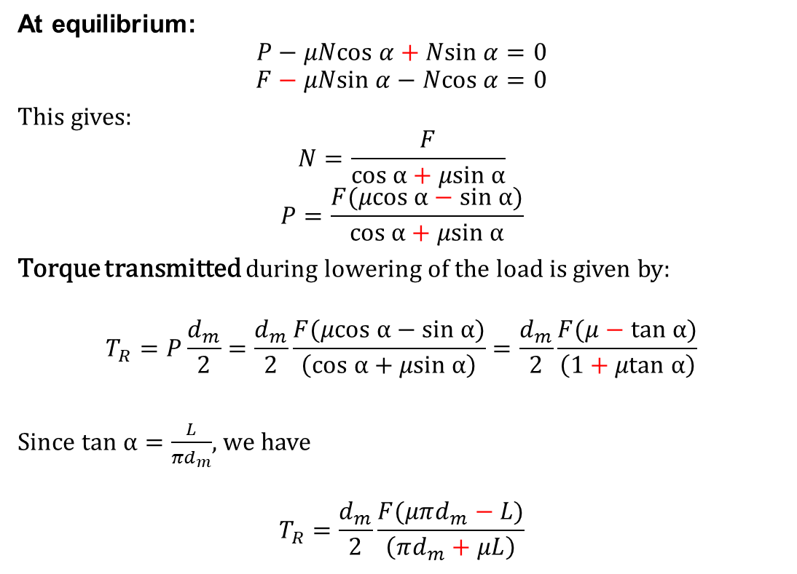
Proof - screw-lowering torque
At equilibrium:
$$P−μNcos α+Nsin α=0$$
$$F−μNsin α−Ncos α=0$$
This gives:
$$N=\frac{F}{cos α+μsin α}$$
$$P=\frac{F(μcos α−sin α)}{cos α+μsin α}$$
Torque transmitted during lowering of the load is given by:
$$T_{R}=P\frac{d_{m}}{2}=\frac{d_{m}}{2}\frac{F(μcos α−sin α)}{\left(cos α+μsin α\right)}=\frac{d_{m}}{2}\frac{F(μ−tan α)}{\left(1+μtan α\right)}$$
Since $tan α=\frac{L}{{πd}_{m}}$, we have
$$T_{R}=\frac{d_{m}}{2}\frac{F(μπd_{m}−L)}{\left(πd_{m}+μL\right)}$$
Other source, note the difference in symbols.

Slide 13
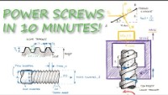

Slide 14
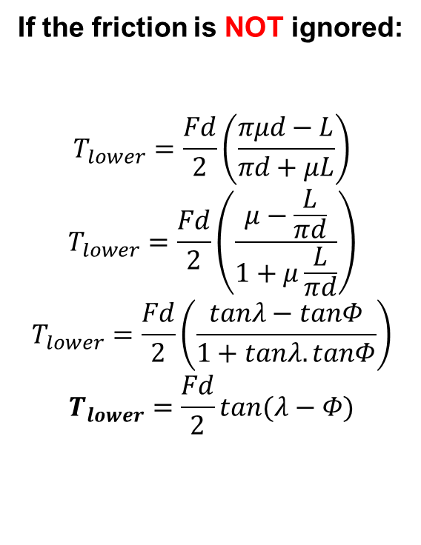
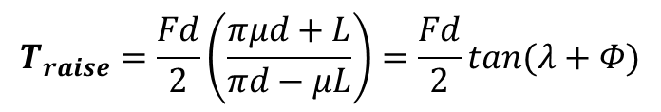
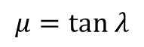
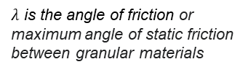
Torques with “screw” as the power transmission mechanism
If the friction is NOT ignored:
$$T_{lower}=\frac{Fd}{2}\left(\frac{πμd−L}{πd+μL}\right)$$
$$T_{lower}=\frac{Fd}{2}\left(\frac{μ−\frac{L}{πd}}{1+μ\frac{L}{πd}}\right)$$
$$T_{lower}=\frac{Fd}{2}\left(\frac{tanλ−tanΦ}{1+tanλ.tanΦ}\right)$$
$$T_{lower}=\frac{Fd}{2}tan(λ−Φ)$$
$λ$ is the angle of friction or maximum angle of static friction between granular materials
$$μ=tan λ$$
Lead (L)
(Φ)
Screw lowering
($λ)$
πd
$$λ$$
(Φ)
$$T_{raise}=\frac{Fd}{2}\left(\frac{πμd+L}{πd−μL}\right)=\frac{Fd}{2}tan(λ+Φ)$$
Or

Slide 15
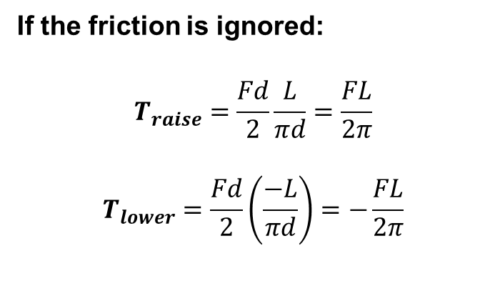
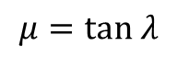
Torques with “screw” as the power transmission mechanism
If the friction is ignored:
$$T_{raise}=\frac{Fd}{2}\frac{L}{πd}=\frac{FL}{2π}$$
$$T_{lower}=\frac{Fd}{2}\left(\frac{−L}{πd}\right)=−\frac{FL}{2π}$$
$$μ=tan λ$$
Lead (L)
(Φ)
Screw lowering
πd

Slide 16
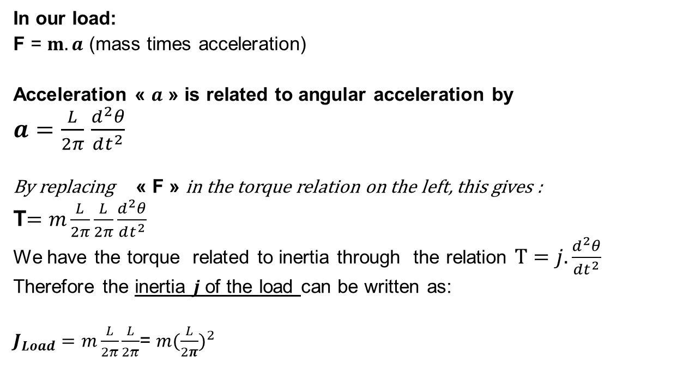
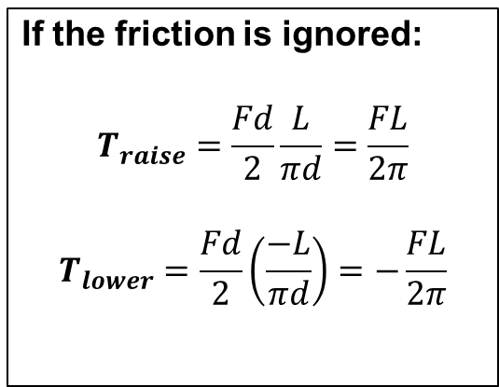
Torques to load inertia with “screw” as the power transmission mechanism
In our load:
F = $m.a$ (mass times acceleration)
Acceleration « $a$ » is related to angular acceleration by
$a=\frac{L}{2π}$ $\frac{d^{2}θ}{dt^{2}}$
By replacing « F » in the torque relation on the left, this gives :
T$=m\frac{L}{2π}\frac{L}{2π}\frac{d^{2}θ}{dt^{2}}$
We have the torque related to inertia through the relation $T=j. \frac{d^{2}θ}{dt^{2}}$
Therefore the inertia $j$of the load can be written as:
$J_{Load}=m\frac{L}{2π}\frac{L}{2π}$= $m{(\frac{L}{2π})}^{2}$
If the friction is ignored:
$$T_{raise}=\frac{Fd}{2}\frac{L}{πd}=\frac{FL}{2π}$$
$$T_{lower}=\frac{Fd}{2}\left(\frac{−L}{πd}\right)=−\frac{FL}{2π}$$

Slide 17
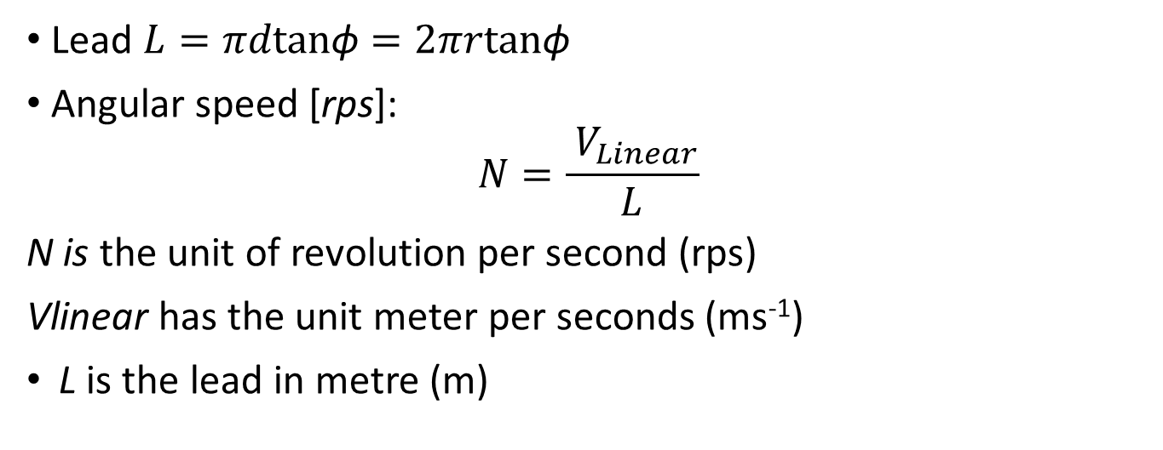
Displacement and speed relations
What follows is the kinematic aspects of a screw during the power transmission (linkage). We want to derive the relation between their rotational motion and the linear motion for displacement and speed
Lead $L=πdtan\text{ϕ}=2πrtan\text{ϕ}$
Angular speed [rps]:
$$N=\frac{{ V}_{Linear}}{L}$$
N is the unit of revolution per second (rps)
Vlinear has the unit meter per seconds (ms⁻¹)
L is the lead in metre (m)
Φ
N_{L}
F_{Load}
Screw
r
Φ is the lead angle.

Slide 18
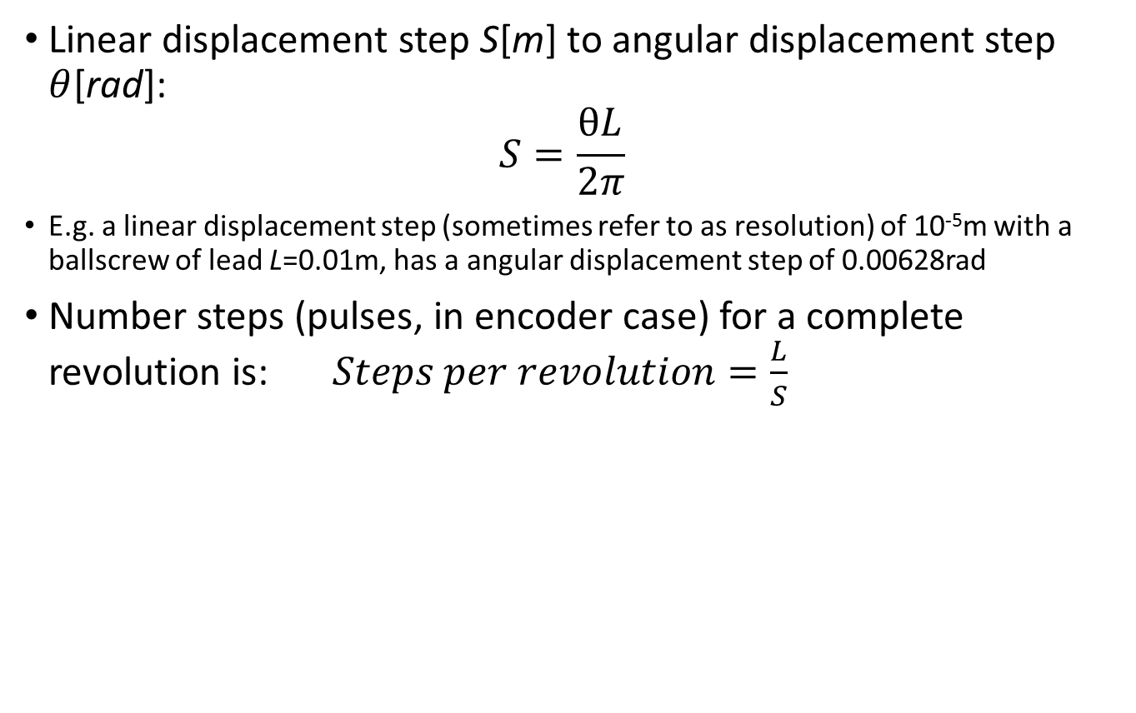
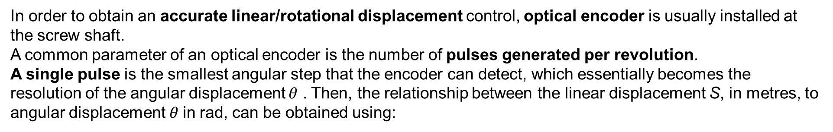
Displacement and speed relations
In order to obtain an accurate linear/rotational displacement control, optical encoder is usually installed at the screw shaft.
A common parameter of an optical encoder is the number of pulses generated per revolution.
A single pulse is the smallest angular step that the encoder can detect, which essentially becomes the resolution of the angular displacement $θ$ . Then, the relationship between the linear displacement S, in metres, to angular displacement $θ$in rad, can be obtained using:
Linear displacement step S[m] to angular displacement step $θ$[rad]:
$$S=\frac{θL}{2π}$$
E.g. a linear displacement step (sometimes refer to as resolution) of 10⁻⁵m with a ballscrew of lead L=0.01m, has a angular displacement step of 0.00628rad
Number steps (pulses, in encoder case) for a complete revolution is:$Steps per revolution=\frac{L}{S}$
N_{L}
F_{Load}
Screw
r
Φ is the lead angle.

Slide 19
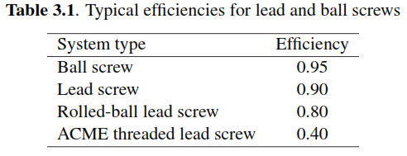
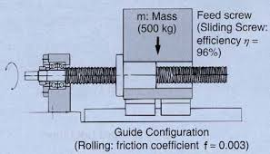
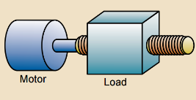
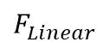
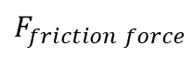
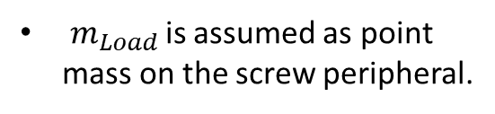
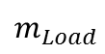
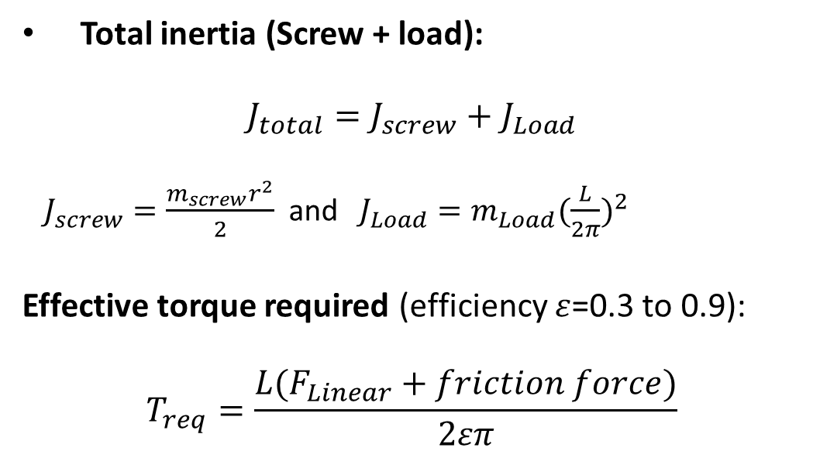

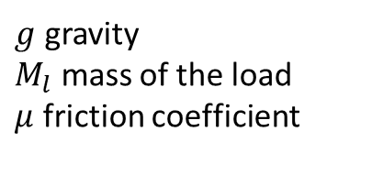

Torque and inertia relations
N_{L}
Screw
F_{Load}
Total inertia (Screw + load):
$$J_{total}=J_{screw}+J_{Load}$$
$J_{screw}=\frac{m_{screw}r^{2}}{2}$ and $J_{Load}=m_{Load}{(\frac{L}{2π})}^{2}$
Effective torque required (efficiency $ε$=0.3 to 0.9):
$$T_{req}=\frac{L(F_{Linear}+friction force)}{2επ}$$
r
$m_{Load }$is assumed as point mass on the screw peripheral.
$$ε=\frac{tan(Φ) }{tan(λ+Φ) }$$
$$F_{f}=M_{l}.g.μ$$
For a planar surface (orthogonal to gravity)
$$Φ=lead angle$$
$$μ(friction coef)=tan λ$$
$g$ gravity
$M_{l}$ mass of the load
$μ$ friction coefficient
$$F_{Linear}$$
$$m_{Load}$$
$$F_{friction force}$$

Slide 20
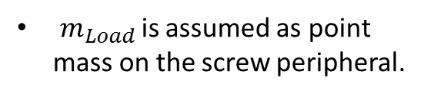
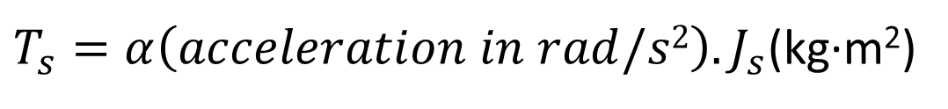
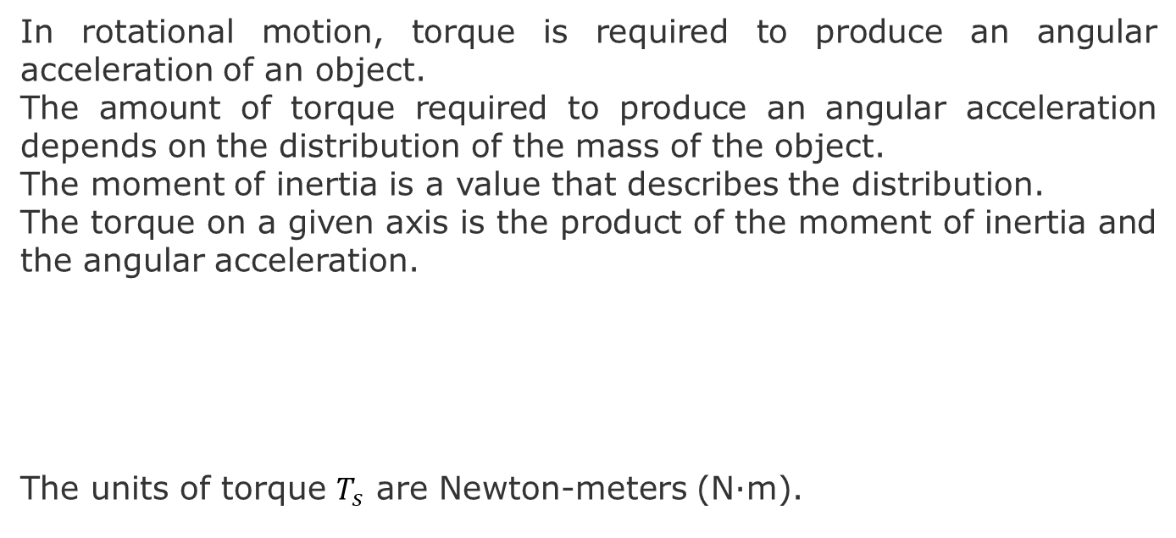
Torque and inertia relations
N_{L}
F_{Load}
Screw
In rotational motion, torque is required to produce an angular acceleration of an object.
The amount of torque required to produce an angular acceleration depends on the distribution of the mass of the object.
The moment of inertia is a value that describes the distribution.
The torque on a given axis is the product of the moment of inertia and the angular acceleration.
The units of torque $T_{s}$ are Newton-meters (N∙m).
r
$m_{Load }$is assumed as point mass on the screw peripheral.
${T_{s}=α\left(acceleration in rad/s2\right).J}_{s}$(kg∙m²)

Slide 21
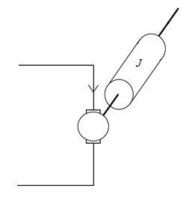
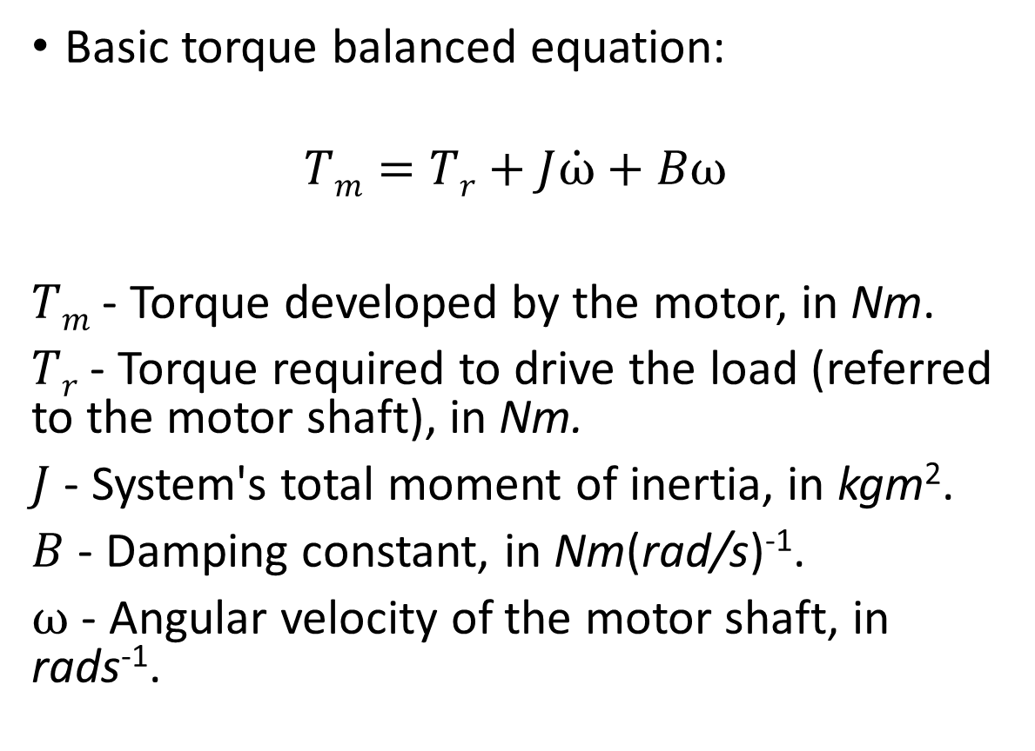
Torque balanced equation
T_{r}
Basic torque balanced equation:
$$Tm=Tr+J\dot{ω}+Bω$$
$Tm$ - Torque developed by the motor, in Nm.
$Tr$ - Torque required to drive the load (referred to the motor shaft), in Nm.
$J$ - System's total moment of inertia, in kgm².
$B$ - Damping constant, in Nm(rad/s)⁻¹.
$ω$ - Angular velocity of the motor shaft, in rads⁻¹.
ω
B
T_{m}

Slide 22
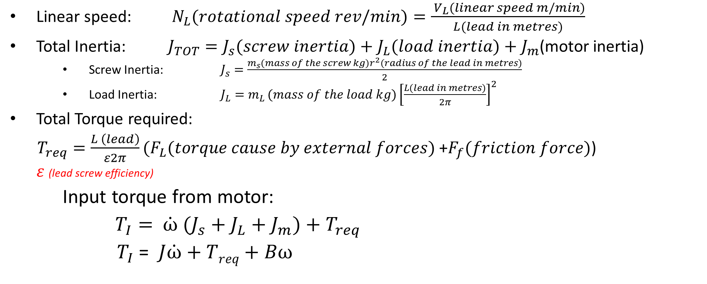
Key Equations
Linear speed: ${ N}_{L}(rotational speed rev/min)=\frac{{ V}_{L}(linear speed m/min)}{L(lead in metres)}$
Total Inertia: $J_{TOT}=J_{s}(screw inertia)+J_{L}(load inertia)+J_{m}$(motor inertia)
Screw Inertia: $J_{s}=\frac{m_{s}(mass of the screw kg)r^{2}(radius of the lead in metres)}{2}$
Load Inertia: $J_{L}=m_{L }(mass of the load kg){\left[\frac{L(lead in metres)}{2π}\right]}^{2}$
Total Torque required:
$T_{req}=\frac{L \left(lead\right)}{ε2π}(F_{L}(torque cause by external forces)$+$F_{f}(friction force)$)
$ε$ (lead screw efficiency)
Input torque from motor:
$T_{I}=$ ${\dot{ω} (J}_{s}+J_{L}+J_{m})+T_{req}$
$T_{I}$ = $J\dot{ω}+Treq+Bω$

Slide 23

Material Damping (optional)

Slide 25
Bearings
A bearing allows constrained relative motion between two or more parts, typically rotation or linear movement.
Plain Bearing
Rolling-element bearing
Fluid Bearing
Magnetic Bearing

Slide 26
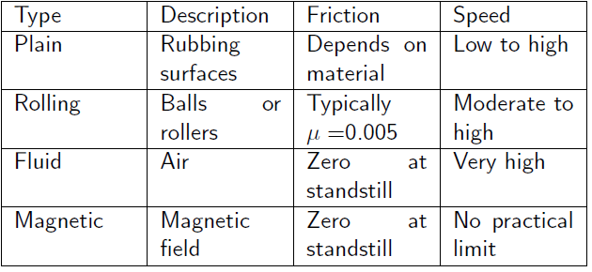
Summary

Slide 27
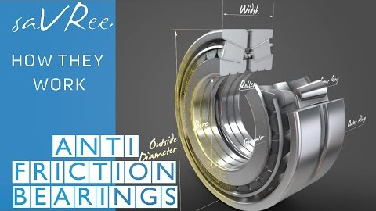
Extra material on Bearings

Slide 28
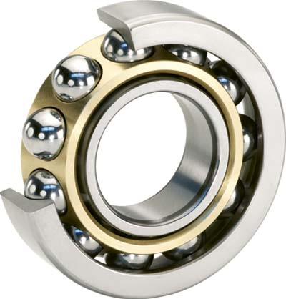
Rigid Single Row Ball Bearings
The balls run in comparatively deep grooved tracks, which make the bearing suitable for both radial load and axial thrust load. The bearing provides location of the shaft relative to the housing.

Slide 29
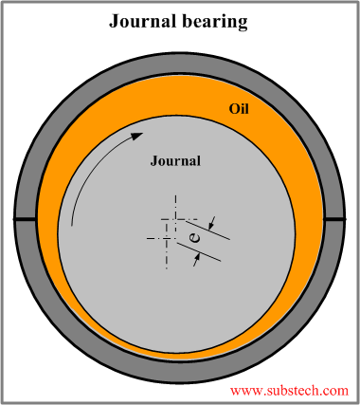
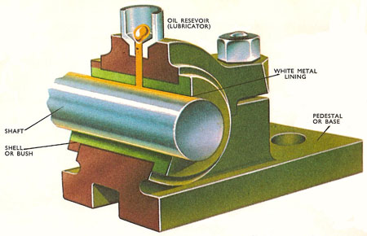
Rigid Single Row Roller Journal Bearing
Basic type of roller bearing commonly used for heavy radial loads. No thrust can be taken, for although one track of the race is lipped, the other race is plain and the bearing does not locate the shaft axially.

Slide 30
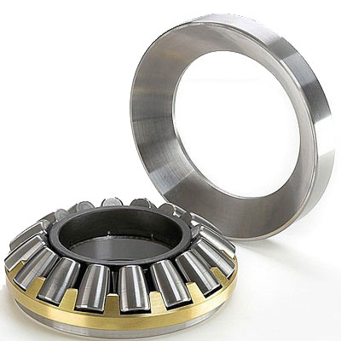
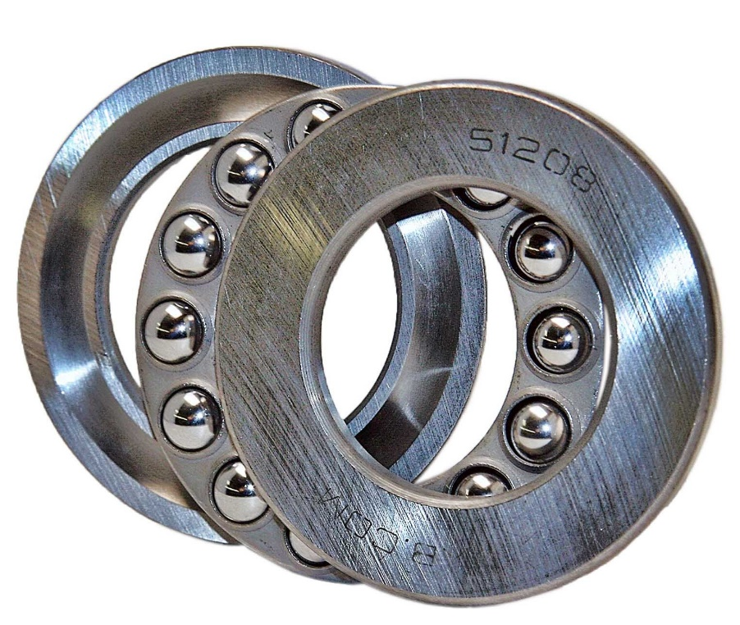
Thrust bearing
The object of thrust bearings is to support thrust and axial loads . Basic type has a shallow grooved track in each washer. The load is taken axially in one direction only. Has a limited speed range.

Slide 31
Air Bearing
In an aerostatic air bearing, the two bearing surfaces are separated by a thin film of compressed air. The distance between the bearing surfaces is about 5 to 30 microns. As the object is supported by a thin layer of air, the friction between the shaft and its housing can be considered to be virtually zero.

Slide 32
Magnetic Bearings
The rotating shaft is supporting in a powerful magnetic field. With no contact, hence no wear, between the rotating and stationary parts. As particle generation due to wear is eliminated, magnetic bearings are suited to clean room applications. Temperature range, typically -250C to 220C.

Slide 33
Couplings
A coupling is used to connect two in-line shafts to allow one shaft to drive the second shaft at the same speed.
A coupling can be rigid or, more normally, flexible to allow relative radial, axial or angular movement of the two shafts.

Slide 34

Extra content on couplers

Slide 35
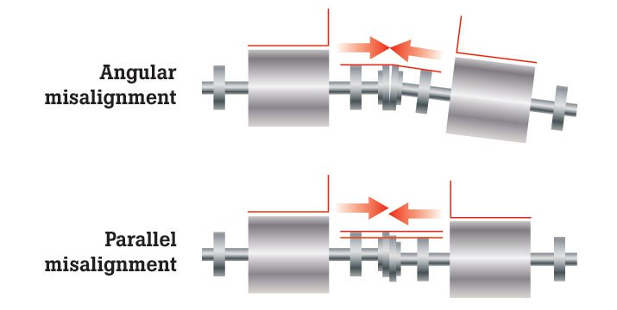
Key Criteria
Angular Misalignment: The axis of two shafts intersect at angles to each other
Parallel Misalignment: The shaft axes of two shafts are parallel but offset from each other.

Slide 36
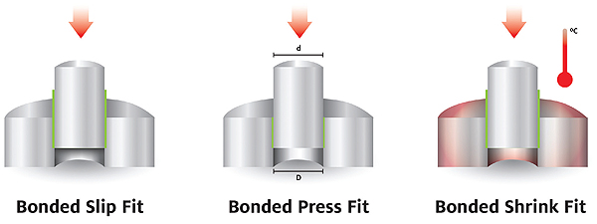
Key Criteria
Interference Fit: Also called a shrink or press fit. The bore is actually smaller than the shaft it is to be mated with. It is the strongest fit possible but requires a thermal differential or an hydraulic press to fit.

Slide 37
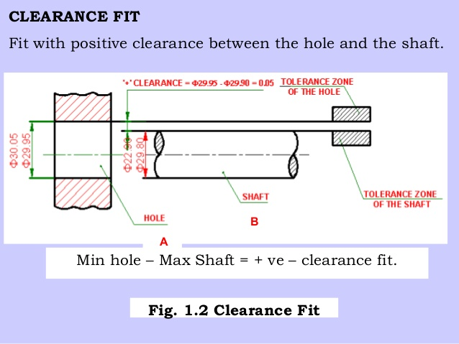
Key Criteria
Clearance Fit: The bore is larger than the shaft. It maintains its position on the shaft through the use of a key and set screw.
End Float: The shafts could be in angular and parallel alignment. However, the shafts move in and out relative to each other.

Slide 38
Solid Couplings

Slide 39
Flexible Couplings

Slide 40
Flexible Couplings

Slide 41
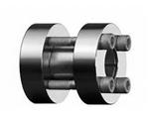
Shear Pin
Used on some couplings, to protect drive and load against overload. The pin is located between coupling halves and is machined to break or shear at a predetermined load.

Slide 42
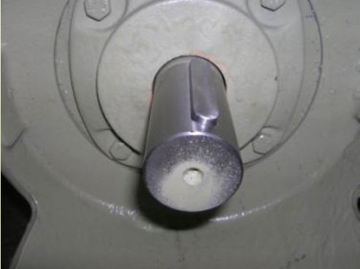
Keys
Key is a component that provides a torque transmitting link between two power-transmitting elements.
The most common types of keys are the square and rectangular parallel keys.
The key width is nominally 0.25 of the shaft diameter.

Slide 43
Spline
A series of axial keys machined into a shaft, with corresponding grooves machined into the mating part.
Integral with the shaft, so no relative motion can occur.
Because of the multiple splines on the shaft, the mating element can be indexed to various position

